Slide 1
Introduction to AI and Assessing the Impact of ESG on Stock Performance and Volatility
Steven Keith Platt, Director of Analytics and Lecturer of Applied AI and Statistics, Loyola University Chicago

Slide 2
Introduction to AI and Assessing the Impact of ESG on Stock Performance and Volatility
AI & Market Potential
Machine Learning
GenAI
How we Execute a Capstone Course
ESG Impact on Stock Performance and Volatility

Slide 3
1. Ai & Market potential
“Artificial intelligence is that activity devoted to making machines intelligent, and intelligence is that quality that enables an entity to function appropriately and with foresight in its environment.”
Nils J. Nilsson, Stanford University, The Quest for Artificial Intelligence

Slide 4
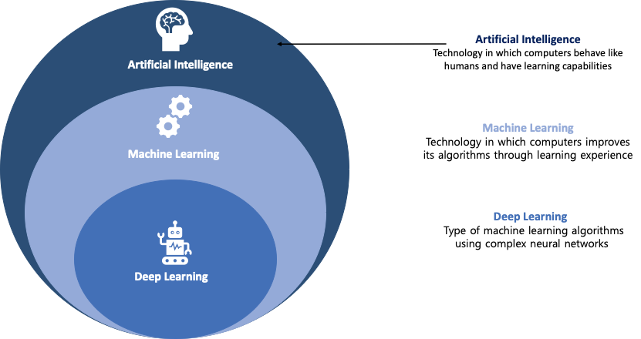
Application Examples:
Self-driving cars.
Autonomous robots.
Chatbots.
Regression and classification predictions.
Facial recognition.
Radiology (medical diagnoses).

Slide 6
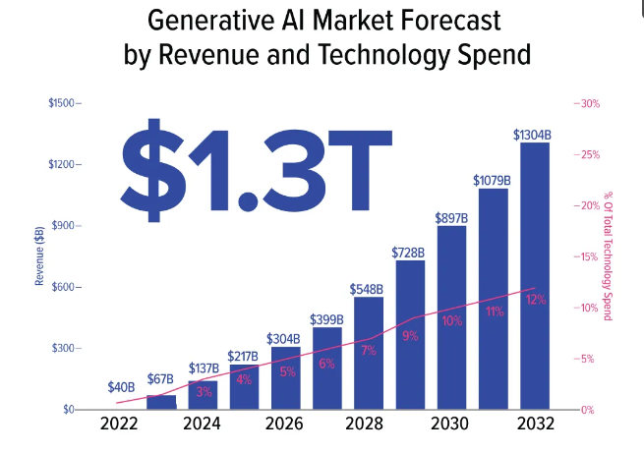
*GenAI will grow from less than 1% of IT spend in 2022 to 12% by 2032.
*42% compound annual growth rate.
*source: Bloomberg Intelligence

Slide 7
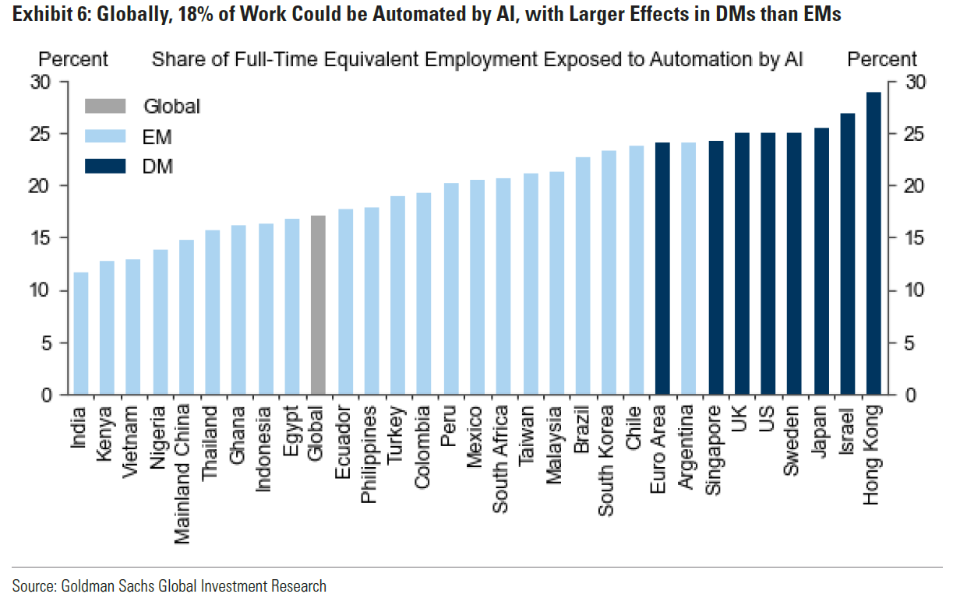
Notes:
Let’s talk about data science jobs. Jobs are an important consideration to students.

Slide 8
Navigating the Jagged Technological Frontier:
Field Experimental Evidence of the Effects of AI on
Knowledge Worker Productivity and Quality
Harvard Business School, 15 September 2023
(study with BCG)
“Across 8 realistic business tasks, AI significantly increased performance and quality for every
model specification, increasing speed by more than 25%, performance as rated by humans
by more than 40%, and task completion by more than 12%.”

Slide 9
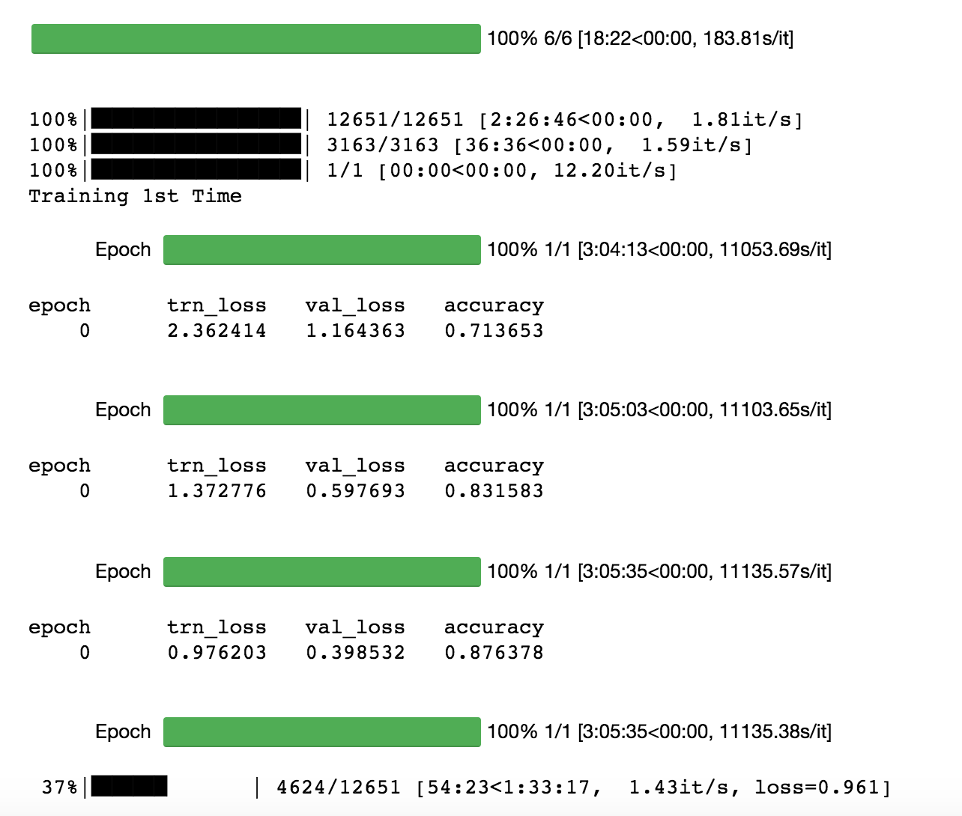
2. Machine Learning
Given training examples/instances of x and y
X= features of that instance (features are properties that describe each instance)
F= trained function/algorithm (model)
Y= output attribute
For each instance, the output is a function of the input vector which we are trying to learn.

Slide 10
Rules Based Programming Approach
Issues:
Very labor intensive to build and update.
Work well for areas they cover, but cannot generalize to unanticipated input combinations. Prediction problematic.
Don’t naturally handle uncertainty.
Hand-crafted knowledge — Where programmers craft sets of rules to represent knowledge in well‐defined domains.

Slide 11
Machine Learning Approach
ML vs. Rules Based Programing:
Don’t reverse engineer an expert’s decision process.
Machine “learns” on its own.
We provide “training data.” i.e. , many examples of labeled data (input x, output y) pairs.
Statistical learning — Where programmers create statistical models for specific problem domains and train them on data.

Slide 12
Objective: Create a product demand function that suggests the optimal timing (when) and depth (percent) of markdowns to realize the highest product margin.
AI Project
WHY?
”Defining discount levels, made possible by data science only recently available to retailers, can boost gross margins by 10% to 20% for in-season and end-of-season sales programs.” (source: Boston Consulting Group).
Using AI for procurement tasks, the average cost savings is 7.9%. (source: Capgemini).

Slide 13
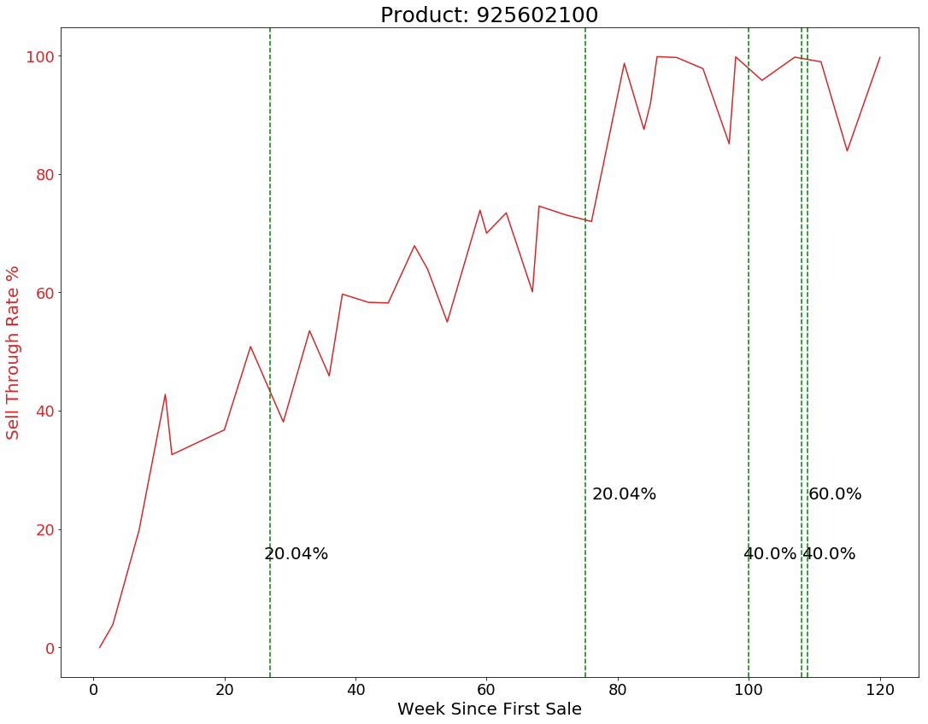
M2
M1
Notes:
Ronit

Slide 14
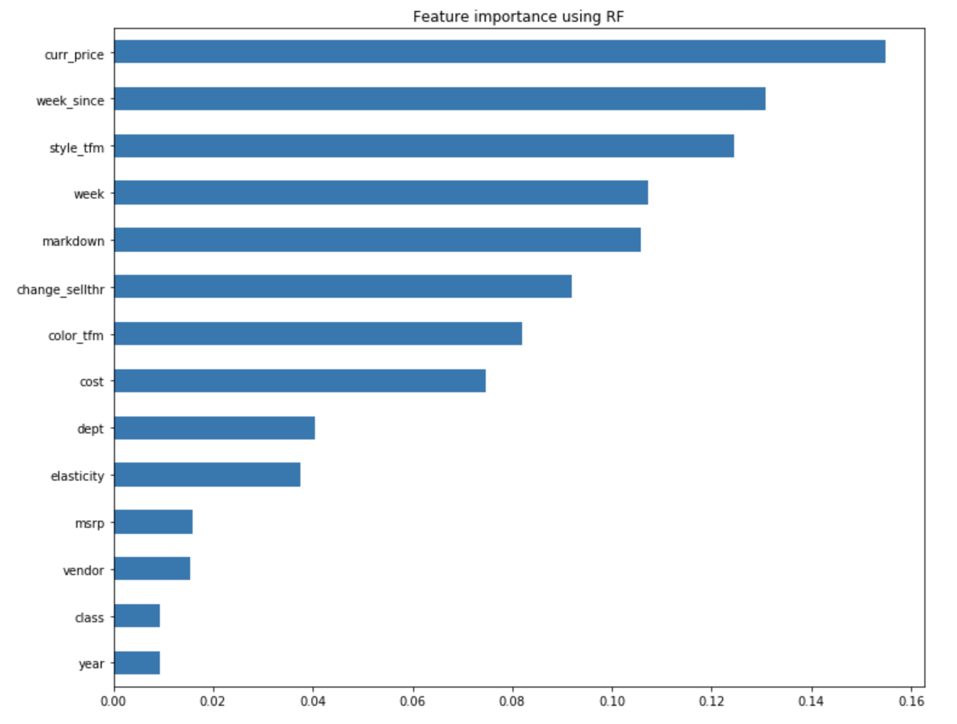
Markdown Optimization-Random Forest Demand Predictions

Slide 15
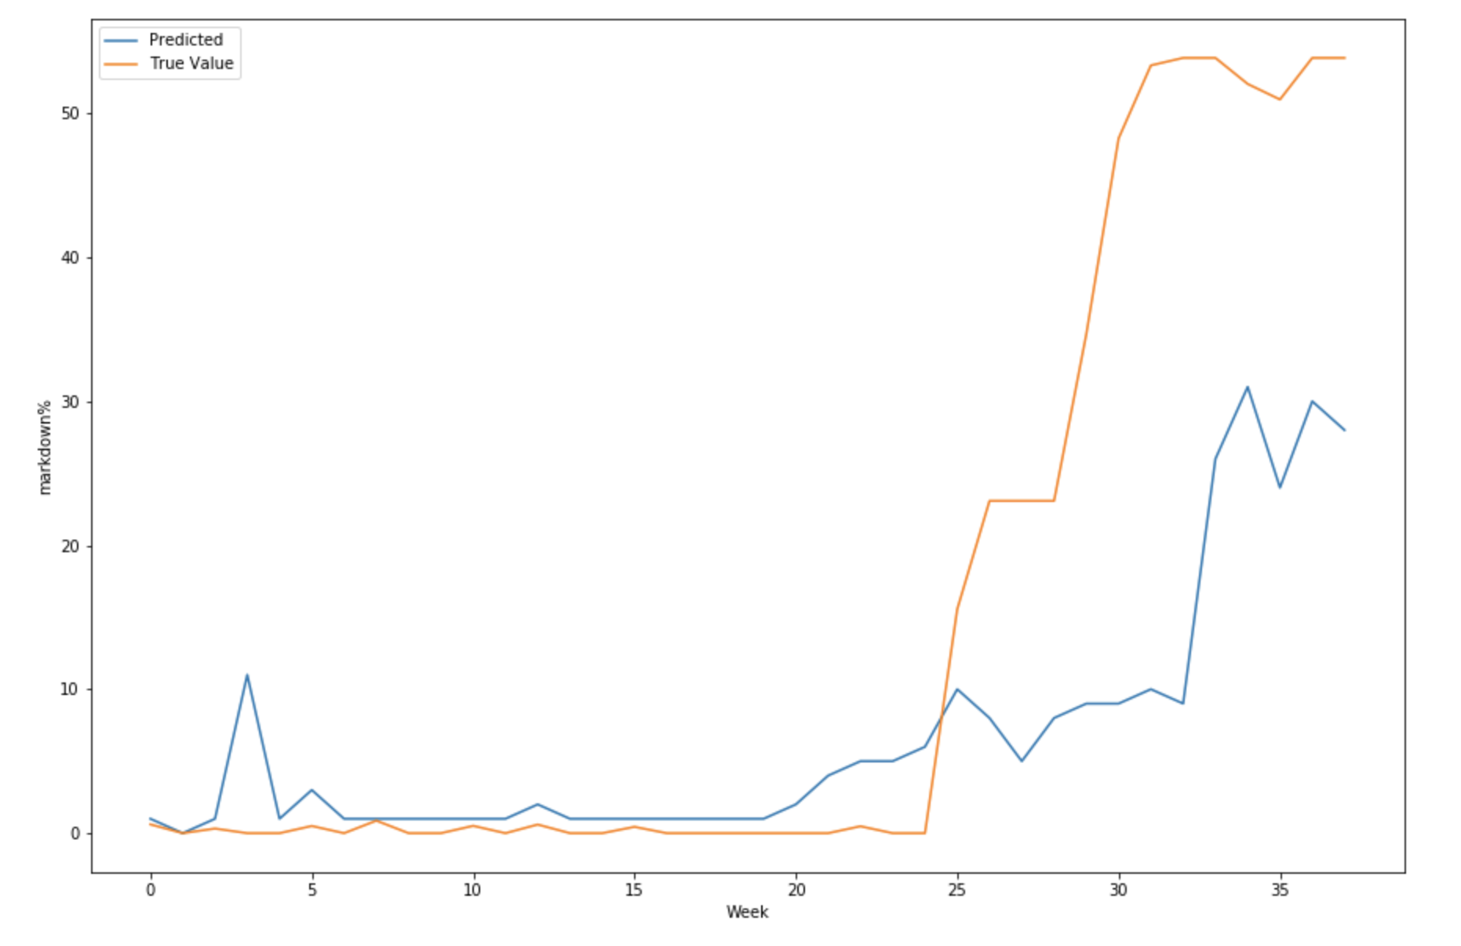
Markdown Suggestion for Products
3 main features:
Style.
Weeks since first sale.
Sell through rate.

Slide 16
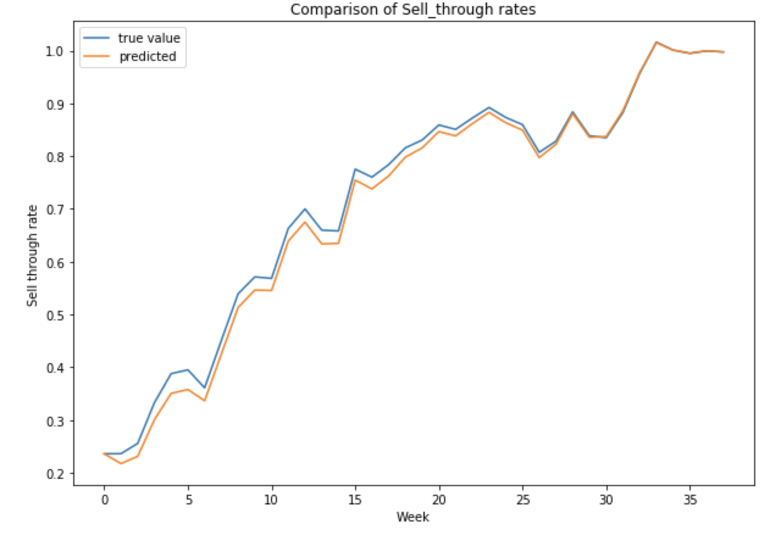
Evaluation of Markdown Model
Average weekly margin actual: 41%.
Average weekly margin based on suggested markdown: 50%.
RESULT: AI model that impacts performance: +9%.

Slide 17
Gen ai
Machine Learning- functions that improve their performance of a predication task with experience.
Generative AI- a model that creates new data, rather than making a prediction about a specific dataset. A generative AI system is one that learns to generate objects that looks like the data it was trained on.
GenAI is simply text prediction, but due to advances in compute and algorithms, this ability to generate has vastly improved.

Slide 18
In this huge corpus of text, words and sentences appear in sequences with certain dependencies.
This recurrence helps the model cut text into statistical chunks that have some predictability.
It learns the patterns of these blocks of text and uses this knowledge to propose what might come next.
Uses self-supervised learning - leverages the inherent structure of the data itself to generate labels for training.
In the context of natural language processing, self-supervised learning enables models to learn from unannotated text, rather than relying on manually labeled data.

Slide 19
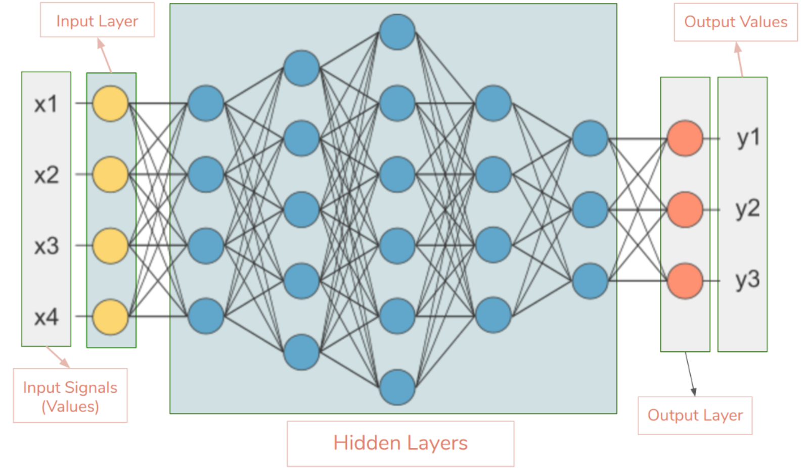
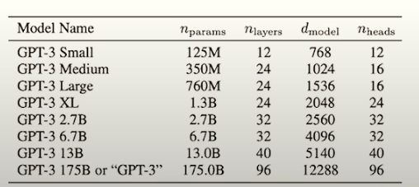
Large Language Models (LLMs)- A class of deep learning models, particularly focusing on natural language processing (NLP) and trained on massive test databases to acquire strong language abilities.
source: Google

Slide 20
Generative AI (GenAI)- a class of apps built on LLMs that can create new content like images, text, audio, translation, summarization, and video.
source: Google

Slide 21
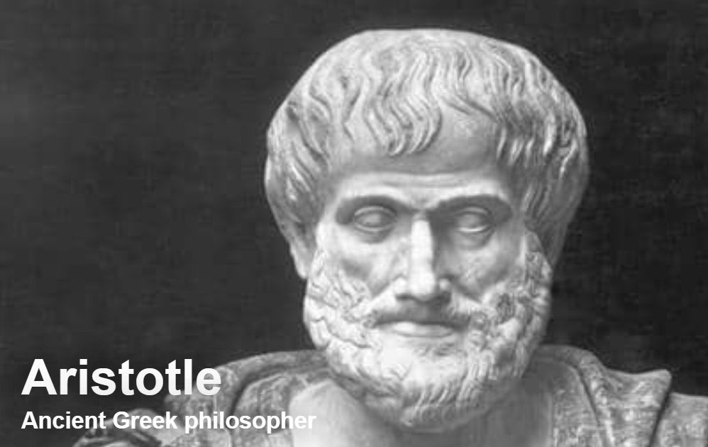
First principals of llms
What is Language?
Aristotle saw language as an object of rational inquiry, a means of expressing and communicating thoughts.
In his view, human language is a kind of man-made arbitrary symbol.
We can, for our purposes, define language as symbolic representations, invited by humans, like math and logic, to communicate.
And what we observe is that there are detectable patterns of communication, as expressed in language.
LLMs, at a very high level, convert human or natural language into computational language capable of imitating humans by applying math.
In general, LLMs aim to model the likelihood of word sequences to predict the probabilities of future word segments.

Slide 22
Human language has an inherent structure and detectable logic. It has grammar, pattern regularity, and similarity.
LLMs are exposed to vast datasets to uncover the statistical relationships that underpin language. As children learn grammar rules and vocabulary, these models recognize how words relate and depend on each other to convey meaning.
LLMs discover that sentences have syntactic and semantic regularities. They learn, for example, that verbs typically follow nouns and that some words are more likely to appear together than others. With enough data, LLMs grasp these nuances, like an expert linguist who has studied the subject extensively.
In sum: LLMs computational power enables them to discern the logical, mathematical patterns woven throughout human communication. It is this recognition of semantics that gives large LLMs their remarkable ability to generate and understand language.

Slide 23
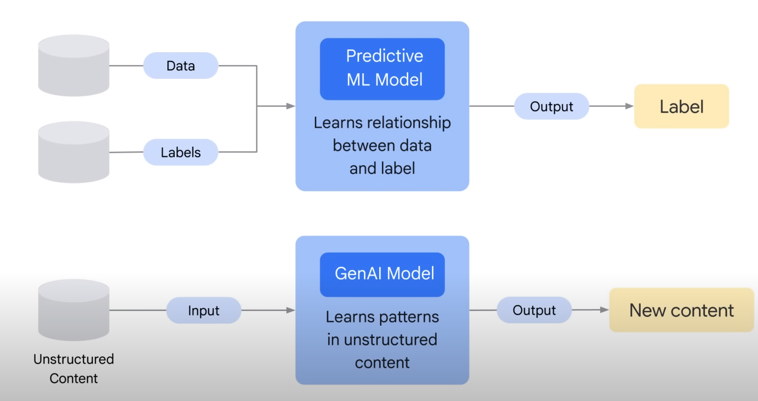
source: Google
How do LLMs Work (we will get to the how shortly)?

Slide 24
Tokenization
Text data is split into smaller chunks called tokens. This is done by splitting on spaces and punctuation. Each token becomes an input data point for the model. The tokenization step takes every word, prefix, suffix, punctuation signs, and sends them to a known token from the library.

Slide 25
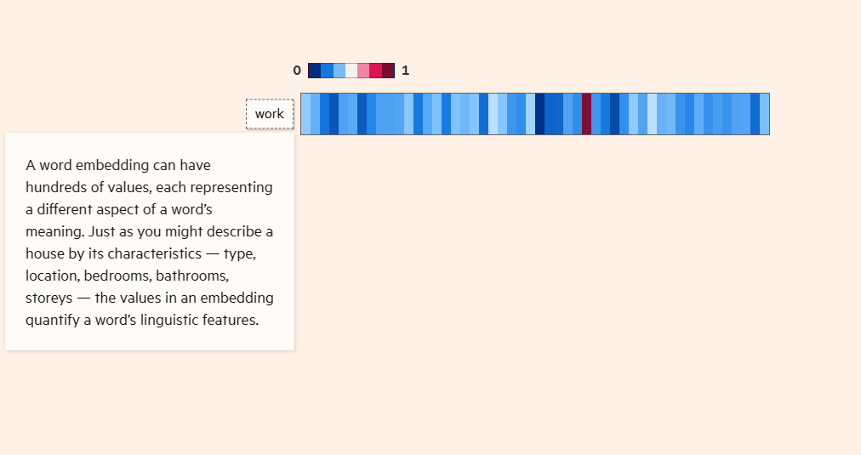
Training an LLM
Vector Representations/Indexing
Each unique token is then assigned an index value, which maps the tokens to numeric vector representations. This step allows the tokens to be processed mathematically but does not encode any meaning. It is a preprocessing step to digitize the word tokens.
If the word “cat” has an index of 17, then every occurrence of “cat” will be converted to the vector [17].
A vector is an array of numbers. We create these vectors by mapping from words to numeric index values. This allows the model to mathematically operate on the word data.
Transformer models use vectors with a dimension of 128, 256, or 512. This means that each vector would hold 128, 256, or 512 numbers.
source: Financial Times

Slide 26
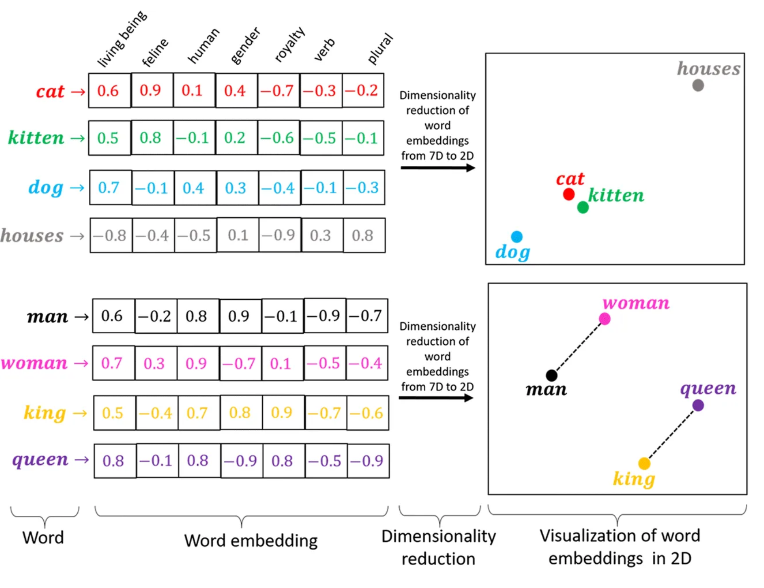
VI. Engineering/Mechanics
Vector Embedding
The vectors are passed through an embedding layer in the neural network which encodes semantic meaning and creates dense vector representations of each token. Tokens with similar meanings are mapped closer together, which encodes semantic meaning. The embedding layer weights are learned during training. As the models are trained, the word embeddings get updated.
For example, "cat" and "feline" vectors will be closer than "cat" and "truck.“
Word and sentence embeddings are the bread and butter of LLMs. They are the basic building block of most language models, since they translate human speak (words) into computer speak (numbers) in a way that captures many relations between words, semantics, and nuances of language into equations regarding the corresponding numbers.
source: Medium

Slide 27
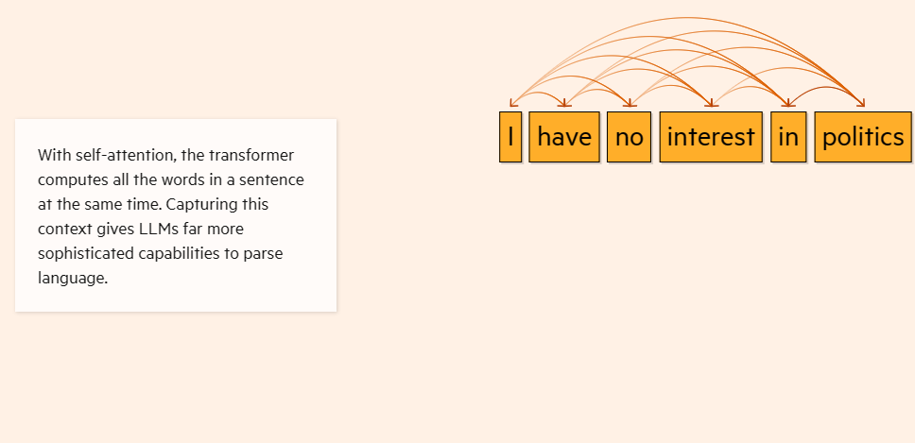
Why are Transformers Special?
1. Attention Mechanism: At the heart of the transformer architecture is the attention mechanism. This allows the model to focus on different parts of the input data with varying degrees of attention, akin to how humans pay attention to specific parts of a sentence when understanding context or meaning. It enables the model to capture long-range dependencies and relationships in data.
2. Scalability: Transformers are highly parallelizable (ability of a computational task to be divided into smaller sub-tasks that can be processed simultaneously, rather than sequentially). Transformers can process data in parallel, making them more scalable and faster in training on hardware accelerators like GPUs.
source: Financial Times

Slide 28
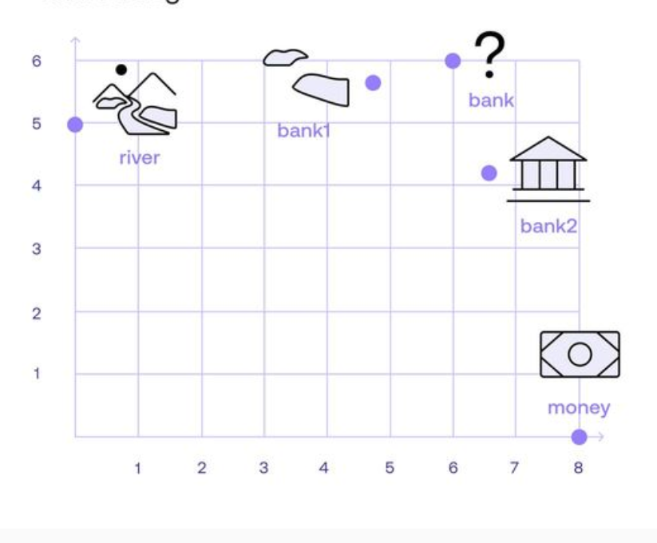
Transformers in AI: Revolutionizing Natural Language Processing
Ability to learn the relevance and context of words.

Slide 29
How we Organize a Capstone Course
A real client with a real business problem.
Examples:
Deloitte- ESG Impact on Stock Performance and Volatility (today’s discussion).
H&M- built AI models to predict product demand to better inform their buying decisions, with the desired outcomes of increasing sales, realizing higher gross margins, and decreasing investment in overstocks.
Designer Brands Inc. (Discount Shoe Warehouse)- to determine optimal shoe size profiles to become more precise with merchandising decisions. The algorithms were developed to allow its merchandisers to input various styles and output size demand predictions.
Petco- built AI models to: 1. map products purchased within customer baskets to ensure dependent SKUs were present in the store, i.e., what are the must-have products, including quantity relationships, and 2. detail the implications of out-of-stocks; that is, what products are substituted when the desired product is not available.
Peapod Digital Labs- built AI models to: 1. Improve the accuracy of online order projections, and 2. Predict online order fulfillment source and method. The outcome is to assist PDL management in its planning fulfillment operations.
Tractor Supply Company- investigated the impact of coupon redemptions on margins and consumer behavior. Models built classify consumers that should/should not receive promotions and that enable testing of various scenarios to predict response rates in relation to changing features.
ULTA Beauty- In this experiment, we considered historical trends in traffic, labor, and sales as impacted by weather. Using a nonparametric tree ensemble model, we were able to accurately predict store traffic two weeks in advance so ULTA can adjust store staffing to positively influence conversion rates and average ticket size.

Slide 30
A real client with a real business problem.
Class is split into teams.
Teaching includes literature review, concept and model concepts.
Students present progress to class on a weekly basis, interact with client, etc.
Deliverables include detailed written project summary, PowerPoint presentations, supporting materials, etc.

Slide 31
Esg capstone

Slide 37
ix. Esg capstone

Slide 39
Register at: https://bit.ly/3M8tFVD- For info. contact- anguyen20@luc.edu

Slide 40
Thank You
Note: this presentation is for instructional/educational purposes only and is not intended for publication or general distribution. Some of the images contained herein may be subject to copyright protection.

